Slide 1

Introduction to Academic Development: Higher Education Learning/Learning to Learn
Laura Perry – l.perry2@londonmet.ac.uk
Academic Mentor

Slide 2
Learning Outcomes
Understand Learning, learning types and how to engage deep learning
Identify the principles of effective learning
Learn the Various methods teachers use with students to probe learning
Understanding learning styles, and study skills and how to develop an effective learning strategy
Value of reflective learning, critical thinking and meta-Learning.

Slide 3
Activity - Hands up
Who is nervous about starting their degree course?
Who is excited?

Slide 4


Activity – Mentimeter (3 mins)
How would you define learning?

Slide 5
Learning Definition
Learning represents a process of knowledge acquisition through a cognitive process of active engagement with the new learning material in order for it to make sense and to develop our understanding.
Learning is a cumulative process that builds upon previous learning to enhance and develop our understanding.
(Oko and Reid, 2017)

Slide 6
‘Learning to Learn’ Definition
‘‘Learning to learn’ is the ability to pursue and persist in learning, to organise one’s own learning, including through effective management of time and information, both individually and in groups. This competence includes awareness of one’s learning process and needs, identifying available opportunities, and the ability to overcome obstacles in order to learn successfully. This competence means gaining, processing and assimilating new knowledge and skill as well as seeking and making use of guidance. Learning to learn engages learners to build on prior learning and life experiences in order to use and apply knowledge and skills in a variety of contexts: at home, at work, in education and training. Motivation and confidence are crucial to an individual’s competence.’ (James, 2023)

Slide 7
Definition (breakdown)
‘Learning to learn’ is the ability to pursue and persist in learning, to organise one’s own learning, including through effective management of time and information, both individually and in groups. This competence includes awareness of one’s learning process and needs, identifying available opportunities, and the ability to overcome obstacles in order to learn successfully. This competence means gaining, processing and assimilating new knowledge and skill as well as seeking and making use of guidance. Learning to learn engages learners to build on prior learning and life experiences in order to use and apply knowledge and skills in a variety of contexts: at home, at work, in education and training. Motivation and confidence are crucial to an individual’s competence (James, 2023).
PURPLE = LEARNING REQUIRES RESILENCE; DARK BLUE = LEARNING IS ACTIVE; GREEN = LEARNING REQUIRES REFLECTION; RED = LEARNING IS SPIRALLED; ORANGE = LEARNING IS HIGHER; LIGHT BLUE = LEARNING REQUIRES MOTIVATION

Slide 8
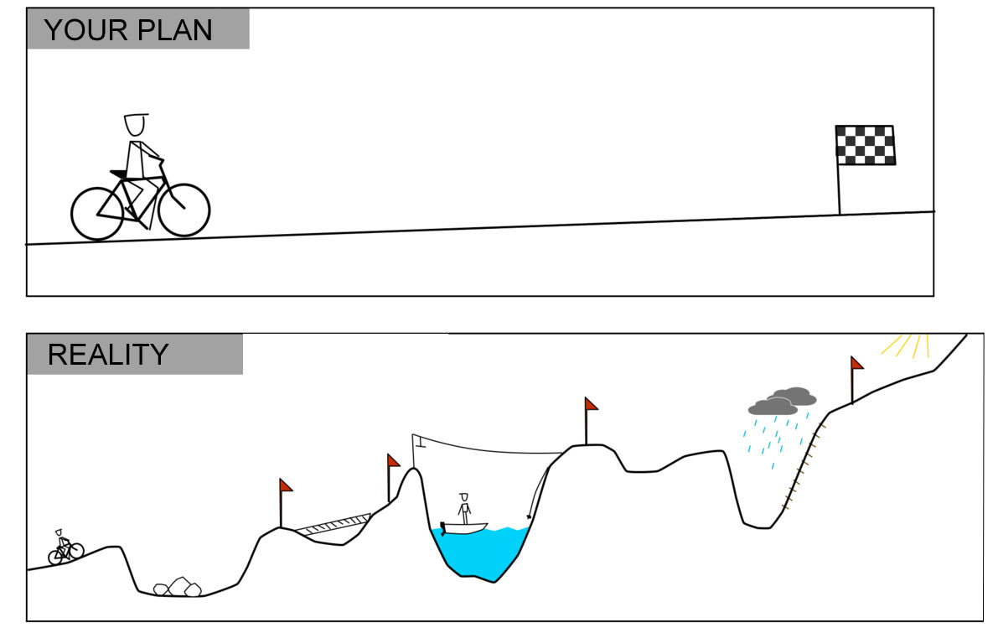
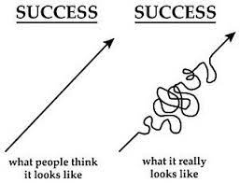
LEARNING REQUIRES RESILIENCE
A resilient learner develops the ability to cope better with errors and hardships rather than allow negative situations to hamper their performance (Wang, 2021)
“Try and fail but do not fail to try” (John Quincy Adams)
Remember each student is on their individual journey
HCPC (2023) SoP - Problem-solving skills
Notes:
SoP = Standards of Proficiency

Slide 9


LEARNING IS AN ACTIVE PROCESS
Students learn more when they are actively engaged in making the learning happen
Active learning can take place through discussion, making active notes, asking questions… but it can also be via Problem- or Project-, Enquiry- and Question Based Learning (Burns and Sinfield, 2022)
VS
Transactional (i.e. passive)
Active
What I hear, I forget; what I see, I remember; what I do, I understand.
-Chinese proverb
Notes:
Problem-based learning -a student-centered approach in which students learn about a subject by working in groups to solve an open-ended problem.
Project-based learning (PBL) - involves students designing, developing, and constructing hands-on solutions to a problem
Enquiry and Research-Based Learning (EBL and RBL) - are terms used to describe a method of teaching and learning based on self-directed enquiry or research by the student.

Slide 10
LEARNING REQUIRES MOTIVATION
Brennen, (2006, cited in Vero and Puka, 2017, p. 58) believes motivation to be “… the level of effort an individual is willing to expend toward the achievement of a certain goal”
According to Williams (2011, cited in Vero and Puka, 2017, p. 58), the five key ingredients impacting student motivation are the:
  Student - Must have access, ability, interest, and value education.
  Teacher – Must be well trained, must focus and monitor the educational process, be dedicated and responsive to their students, and be inspirational.
  Content - Must be accurate, timely, stimulating, and pertinent to the student’s current and future needs.
  Method/process - Must be inventive, encouraging, interesting, beneficial, and provide tools that can be applied to the student’s real life.
  Environment - needs to be accessible, safe, positive, personalized as much as possible, and empowering

Slide 11
Activity – Mentimeter (5 mins)
What is your motivation for studying physiotherapy?
How can you maintain a good level of motivation in your studies?

Slide 12
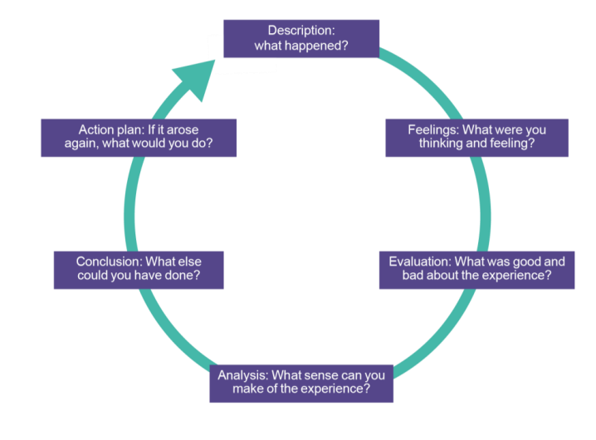
LEARNING REQUIRES REFLECTION
Reflection: ‘a deliberate and conscientious process that employs a person’s cognitive, emotional, and somatic capacities to mindfully contemplate on past, present, or future (intended or planned) actions in order to learn, better understand and potentially improve future actions’ (Harvey, Coulson and McMaugh, 2016, p. 19)
Without reflection there is no learning (hot stove example)
It is vitally important to make the learning content and the learning process conscious
Figure 1: Gibbs’ reflective cycle (Harvey et al., 2020)

Slide 13
LEARNING REQUIRES REFLECTION
Reflection for action - usually occurs before engaging in an activity.
Reflection in action - occurs during the learning activity.
Reflection on action (most valuable) – occurs post the activity/experience and it involves reviewing and synthesising learning and considering any future application (Harvey et al., 2020).
HCPC (2023) SoP -At the point of registration, physiotherapists must be able to:
10. reflect on and review practice

Slide 14
Activity – Mentimeter
Think back to an effective learning experience in education and consider what made it effective?

Slide 15
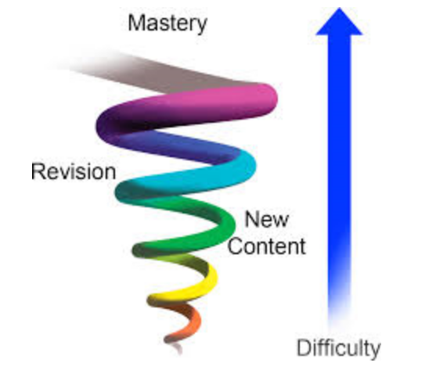
LEARNING IS SPIRALLED
Learning is visualised as a spiral upwards from basic to advanced concepts, with topics being revisited at increasing levels of complexity as the spiral loops round (Ireland and Mouthaan, 2020).
To be remembered, new information must be meaningfully connected to prior knowledge, and it must first be remembered in order to be learned (Angelo, 1993).
Figure 2. Spiral Curriculum

Slide 16
LEARNING IS HIGHER
Surface Learning
Rote memorisation
Deep/Higher Learning
Higher learning is as an active, interactive process that results in meaningful, long-lasting changes in knowledge, understanding, behaviour, dispositions, appreciation, belief, etc. It goes beyond rote memorisation (Angelo, 1993).

Slide 17
LEARNING IS HIGHER
Table 1. Deep vs Surface Learning (Waldan, 2013)
Deep Learning | Surface Learning
Relates topic and ideas to past knowledge and experiences | Unreflective approach; facts not elaborated on.
Thinks critically about newly learned material | No interaction with content or ideas
Ties in information from other sources | Concentrates only on memorisation
Creates new arguments and understands logic based on new information | Underlying argument not comprehended
Recognises a structure in the content | Treats the task as like a monotonous chore
Motivation from within, wants to learn | External incentive, based on demands of a test
Aims to understand the meaning behind the material | Aims to recite and regurgitate material inactively

Slide 18
LEARNING IS HIGHER
Avoid being motivated by assessments = ↑risk of developing a surface approach
To support you in moving towards a deep learning approach, a variety of learning activities are used in class:
  Group work
  Case studies
  Presentations
Important to engage in these activities so that when it comes to your assessment you can be confident in your abilities to apply the knowledge you have learnt to different contexts and in different mediums.
(Oko and Reid, 2017)
Notes:
.

Slide 19
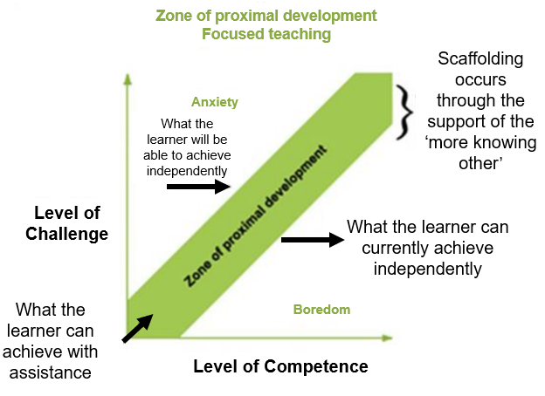
Learning happens outside your comfort zone
Get comfortable being uncomfortable!
You get out what you put in
Figure 1- Vygotsky’s (1978) idea of the zone of proximal development

Slide 20
Principles of Effective Learning
Learning is most effective when the following conditions are met:
1. A clear structure, framework, scaffolding surrounds, supports and informs learning;
2. High standards are expected of learners, and are made explicit;
3. Learners acknowledge and use their prior learning and their particular approaches to learning;
Baume and Scanlon, 2018

Slide 21
Principles of Effective Learning
Learning is most effective when the following conditions are met:
4. Learning is an active process;
5. Learners spend lots of time on task, that is, doing relevant things and practising;
6. Learning is undertaken at least in part as a collaborative activity, both among students and between students and staff; and
7. Learners receive and use feedback on their work.
Baume and Scanlon, 2018

Slide 22
Importance of Feedback
Feedback provides an opportunity for you to reflect on your approach to study, gauge your understanding, plan and take an active role in managing your learning.
Feedback (peer, tutor, practice educator) is important as it should contribute towards developing your understanding
Two types:
  Formative
  Summative
No one is perfect, there is always something to improve
Feedback requires engagement to improve (read/listen, discuss, implement).
Use feedback to think forward (i.e. if I did this again what could I do differently to improve it?)
(Oko and Reid, 2017)

Slide 23
Methods teachers use with students to probe learning
Questioning (follow ups, timed silence)
Reflection i.e. one minute paper
Mentimeter (i.e. mini quizzes)
Think-pair-share
Case studies

Slide 24
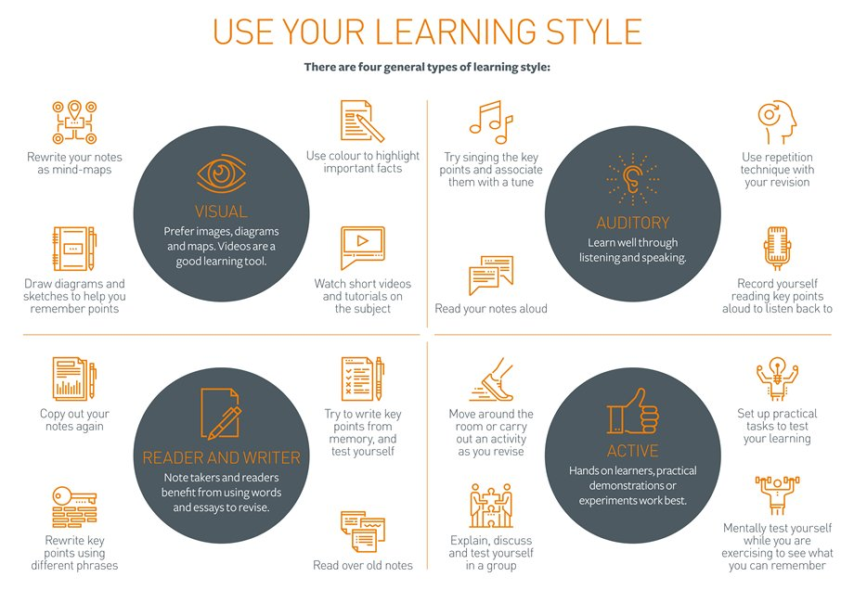
Learning Styles

Slide 25
LEARNING STYLES AND STRATEGIES
Index of Learning Styles (ILS):
Active reflective learners
Sensing intuitive learners
Visual verbal learners
Sequential global learners

Slide 26
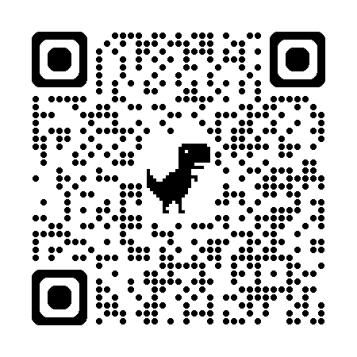
Pre-session Activity – What is your learning style? (5 minutes)
Let us know your learning style preferences:
Or google ‘index of learning styles questionnaire’ and it should be the first website.
Note. The questionnaire is just indicative of learning style not definitive

Slide 27

Active vs reflective learners
Active learners:
Retain and understand information best by doing something active with it—discussing or applying it or explaining it to others
Tend to like working in groups
Reflective learners
Prefer to think about it quietly first
Tend to like working on their own
Let’s try it out and see how it works
Let’s think it through first

Slide 28
Sensing vs intuitive learners
Sensing learners:
Tend to like learning facts
Like solving problems by well-established methods and dislike complications and surprises
Tend to be patient with details and good at memorizing facts and doing hands-on (laboratory) work
Tend to be more practical and careful
Don’t like courses that have no apparent connection to the real world

Slide 29
Sensing vs intuitive learners
Intuitive learners:
Prefer discovering possibilities and relationships.
Like innovation and dislike repetition
May be better at grasping new concepts and are often more comfortable with abstractions and mathematical formulations
Tend to work faster and to be more innovative.
Don’t like courses that involve a lot of memorization and routine calculations.

Slide 30



Visual vs verbal learners
Visual Learners:
Remember best what they see—pictures, diagrams, flow charts, timelines, films, and demonstrations.
Verbal Leaners:
Get more out of words—written and spoken explanations.

Slide 31

Sequential vs global learners
Sequential learners:
Tend to gain understanding in linear steps, with each step following logically from the previous one.
Tend to follow logical stepwise paths in finding solutions

Slide 32
Sequential vs global learners
Global Learners:
Tend to learn in large jumps, absorbing material almost randomly without seeing connections, and then suddenly “getting it.”
May be able to solve complex problems quickly or put things together in novel ways once they have grasped the big picture, but they may have difficulty explaining how they did it.

Slide 33
Learning styles
Due to the variety of learning styles, a variety of learning and teaching strategies are utilised to help maximise learning:
seminars
case studies;
problem-based learning;
group work;
lectures;
practice learning opportunities
presentations;
role-plays;
service user and carer involvement;
(Oko and Reid, 2017)

Slide 34
Tips for Better Learning
“cramming,” should be avoided.
Focus on brain health (diet, exercise, stress, social support)
Practice elaborative rehearsal (5Ws; linking to prior learning)
Take advantage of the testing effect (e.g. practice papers)
Space your learning/training sessions (recap lecture notes regularly)
Develop focused attention; it is a foundation of learning

Slide 35
Critical Thinking
‘Critical thinking is the art of making clear, reasoned judgements based on interpreting, understanding, applying and synthesising evidence gathered from observation, reading and experimentation’ (Burns and Sinfield, 2016, p. 94)
Developing critical thinking skills is essential to your success at University and beyond.
Information-rich world (websites, blogs, Chat GPT, journal articles, lectures)
It is not just about finding faults (e.g. is a measurement realistic e.g. 160 m for height, credibility of the source, date of the research, methods used, sample used, paucity of research, sample size, conflicts of interest)
Becomes easier with practice
Why do we prefer you to use journal articles?

Slide 36
Plenary Activity – One Minute Paper
Write down one thing you have learned from today’s sessions and one thing you are unsure of/confused about?

Slide 37



Support Team
Course leader
Module leaders
Success Coaches
Academic Mentors
Academic Liaison Librarians
Student Services
School Office
Students’ Union
Careers and Employability Service
Personal Academic Tutors
YOU

Slide 38
Any Questions?

Slide 39
References
Angelo, T. A. (1993) ‘Teacher’s Dozen: Fourteen General, Research-Based Principles for Improving Higher Learning in our Classrooms’, AAHE Bulletin, 45(8), pp. 3-13.
Burns, T. and Sinfield, S. (2022) Staff Toolkit: Developing Academic ‘Skills’
Harvey, M., Lloyd, K., McLachlan, K., Semple, A-L. and Walkerden, G. (2020) Reflection for learning: a scholarly practice guide for educators. Available at: https://s3.eu-west-2.amazonaws.com/assets.creode.advancehe-document-manager/documents/advance-he/Adv_HE_Reflection_for_Learning_Guide_1580298564.pdf (Accessed 23 January 2024).
Harvey, M., Coulson, D., and McMaugh, A. (2016) ‘Towards a theory of the ecology of reflection: reflective practice for experiential learning in higher education’, Journal of University Teaching and Learning Practice, 13(2), pp. 1-20. doi: 10.53761/1.13.2.2.
HCPC (2023) The standards of proficiency for physiotherapists. Available at: https://www.hcpc-uk.org/standards/standards-of-proficiency/physiotherapists/ (Accessed 23 January 2024).
Ireland, J. and Mouthaan, M. (2020) ‘Perspectives on curriculum design: comparing the spiral and the network models’, Research Matters: A Cambridge Assessment publication, 30, pp. 7-12.
James, M. E. (2023) ‘Assessing and learning, and learning to learn’, in Tierney, R. J., Rizvi, F., and Ercikan, K. (eds) International Encyclopedia of Education (Fourth Edition). Oxford: Elsevier, pp. 10–20. doi: 10.1016/B978-0-12-818630-5.09015-1.
Oko, J. and Reid, J. (2017) Study Skills for Health and Social Care Students. London: Sage Publications.
Waldan, J. (2013) Deep and Surface Learning: The Literature. Available at: https://www.psy.gla.ac.uk/~steve/courses/archive/CERE12-13-safari-archive/topic9/webarchive-index.html (Accessed 23 January 2024).
Wang, L. (2021) ‘The Role of Students’ Self-Regulated Learning, Grit, and Resilience in Second Language Learning’, Frontiers in Psychology, 12. doi: 10.3389/fpsyg.2021.800488.

Slide 40
References
Vero, E. and Puka, E. (2017) The importance of motivation in an educational environment. Available at: https://core.ac.uk/download/pdf/322532474.pdf (Accessed: 23 January 2024).
Baume, D. and Scanlon, E. (2018). What the research says about how and why learninghappens. In: R. Luckin, ed., Enhancing Learning and Teaching with Technology - What theResearch Says, 1st ed. London: UCL IoE Press, pp.2-13

